Slide 1
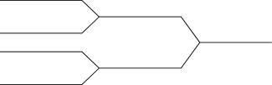


CSE 251
Electronic Devices and Circuits
Lecture 1
Course instructor:
Ankan Ghosh Dastider (AGD)
Lecturer, Department of Computer Science and Engineering, School of Data and Sciences, Brac University
Email: ankan.ghosh@bracu.ac.bd

Slide 2

Lecture 1: Introduction
Mathematical Operations
Addition: 4 + 5 ➔ 9 (0100 + 0101 ➔ 1001)
Subtraction: 10 – 9 ➔ 1 (1010 + 0111 ➔ 0001)
Multiplication: 5x4 = 4+4+4+4+4 = 20
Division: 10/2 = 2 can be subtracted from 10, 5 times

Slide 3
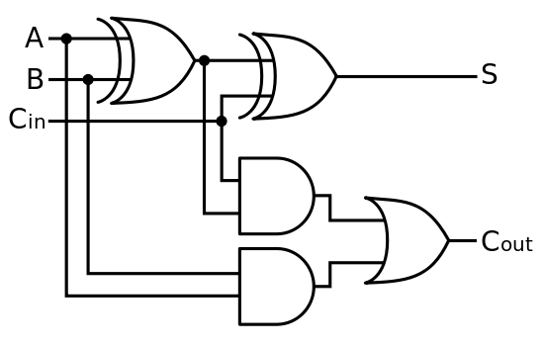
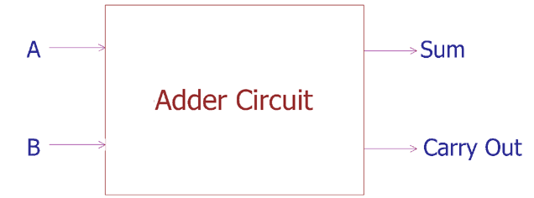
Digital Logic Circuit
Addition: 4 + 5 ➔ 9 (0100 + 0101 ➔ 1001)

Slide 4
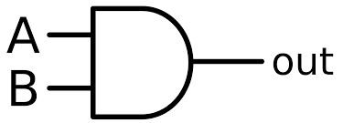
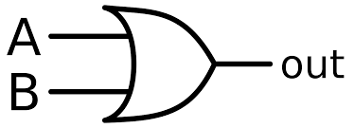
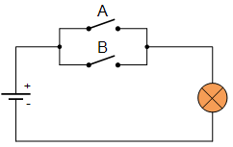
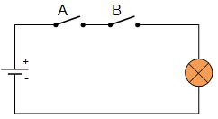
Logic gates are basically switches
AND Gate
OR Gate
The faster you can operate these switches, the faster you can complete the functions!!!

Slide 5
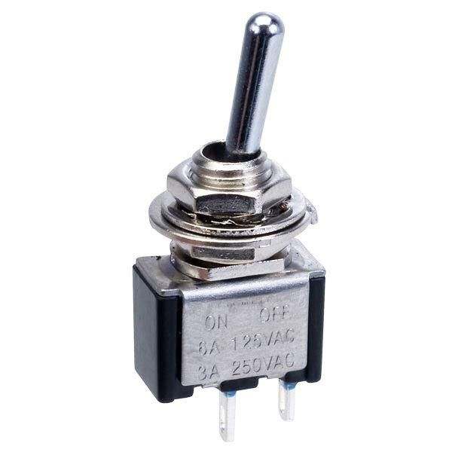
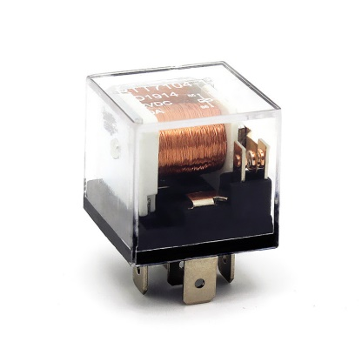
How can we make these switches?
Mechanical switch
Bulky and heavy
Mechanical wear over time
Noisy
Ultra slow
Requires lots of energy to operate
SPST Switch
Electromechanical Relay

Slide 6
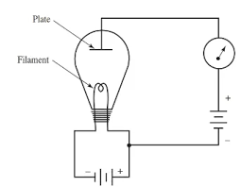
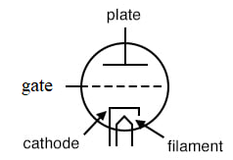
How can we make these switches?
Vacuum tube
To ensure current passes along one direction and stops flowing in the other direction
Gate allows us to control this is a more robust way
Image: From All Abouts Circuits Chapter 13 - Electron Tubes. Available online: allaboutcircuits.com/textbook/semiconductors/chpt-13/the-triode/ and Vacuum Tubes: The World Before Transistors. enginnering.com. Available online: engineering.com/story/vacuum-tubes-the-world-before-transistors

Slide 7
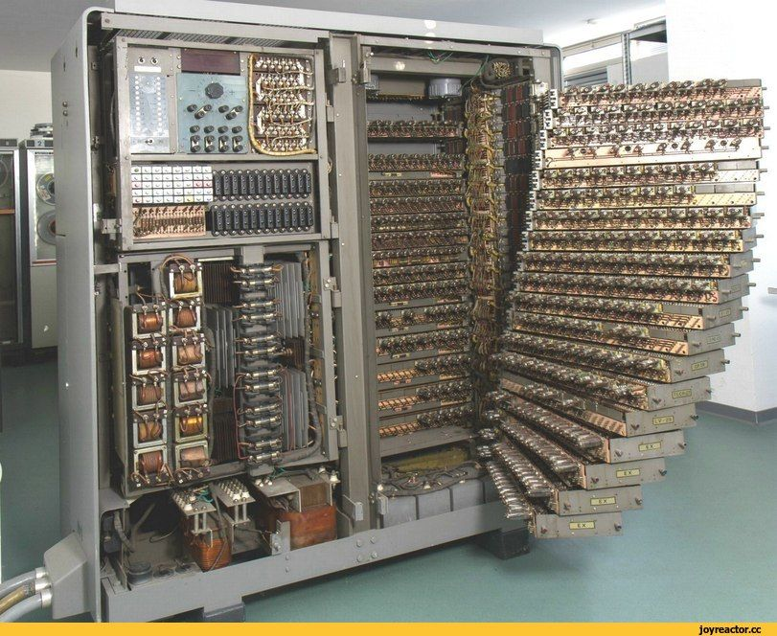
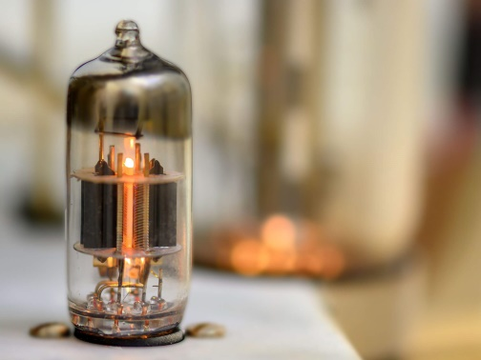
How can we make these switches?
Vacuum tubes
Bulky
Lots of energy
Not scalable

Slide 8
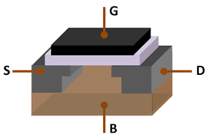
How can we make these switches?
Electronic switches
No moving parts
Scalable
High speed
5GHz computer → 5 billion operations per second !!!

Slide 9
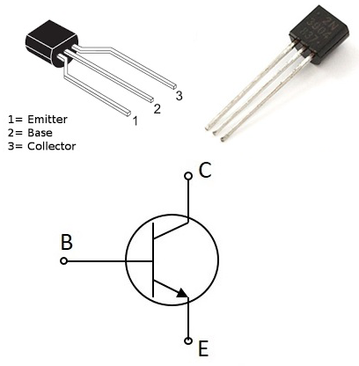
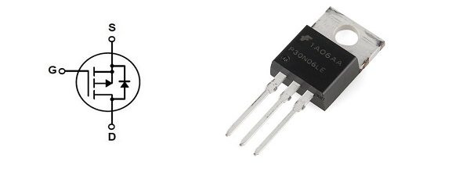
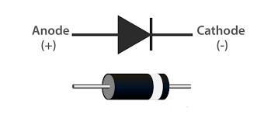
What are electronic circuits?
Any circuit consisting of semiconductors.
Diode
BJT
MOSFET

Slide 10
Transistor: probably the most impactful invention of the present world
Why do we need this course?
High Level Programming → Assembly language → Machine language → Architecture…
…Architecture → System level → Gate → Transistor
(C, C++, etc.)
(x86, ARM, CUDA, etc.)
(100110)
(RISC, CISC, etc.)
(Register, Mux)
(AND, OR, etc.)

Slide 11
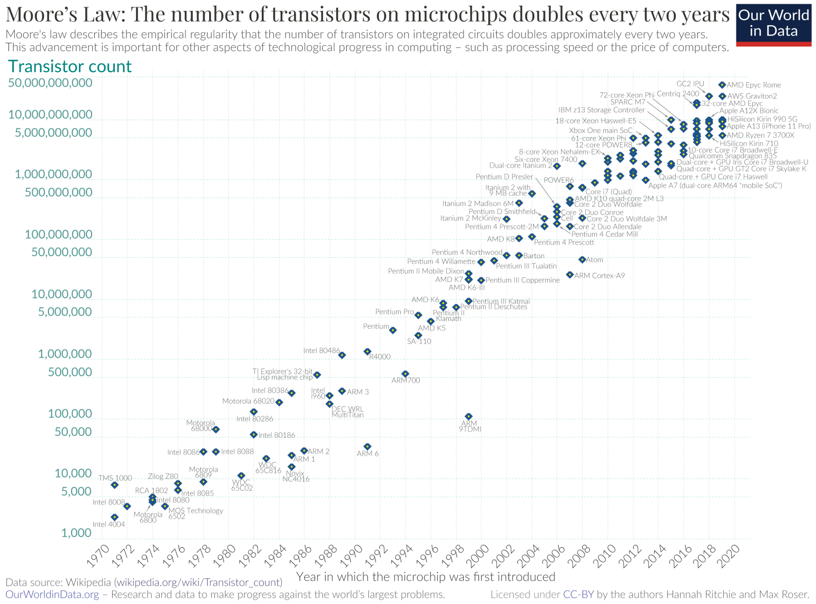

Slide 12
Why do we need electronic circuits?
Digital Electronics
Boolean logic
Addition, subtraction, multiplication, division
Analog Electronics
Amplifiers, radio transmitter and receivers, modulator
Power Electronics
Motor control
AC to DC conversion or vice versa
HVDC circuits
Charge control circuits

Slide 13
Thank you!

